Slide 1
Cloud Computing Between Android Peers
By Zijiang Yang, Yue Zhao

Slide 2
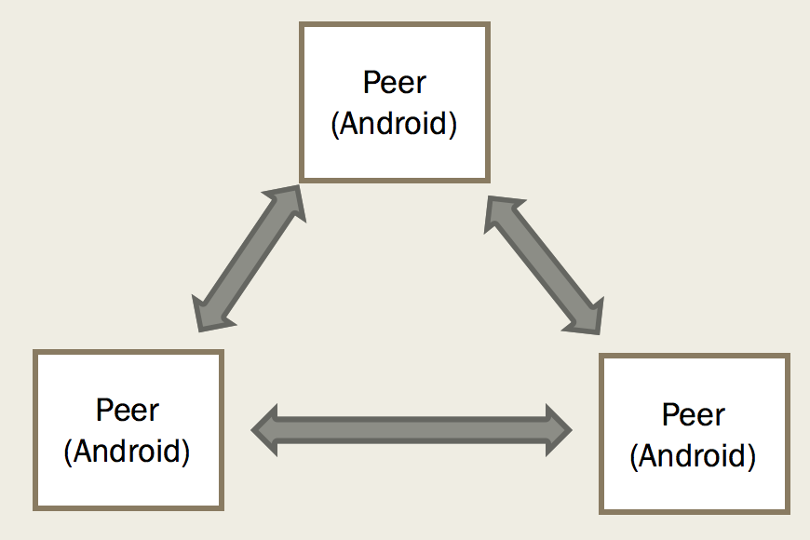
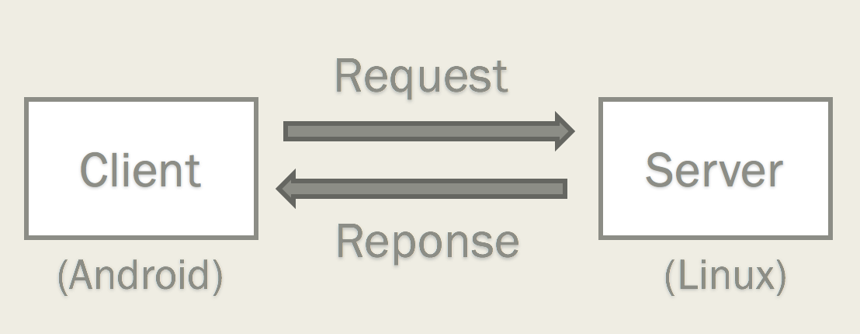
Client-Server Architecture
Peer Computing Architecture

Slide 3
Goals
Migrate method execution from one Android device to another Android device.
Flexible, can migrate MOST methods to ANY Android devices
No need to change existing source code, only need to add annotations to source code and change build script.

Slide 4
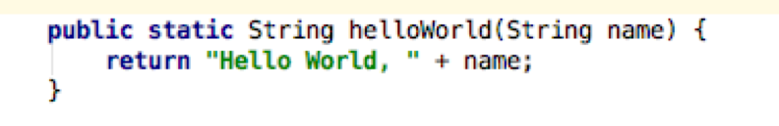
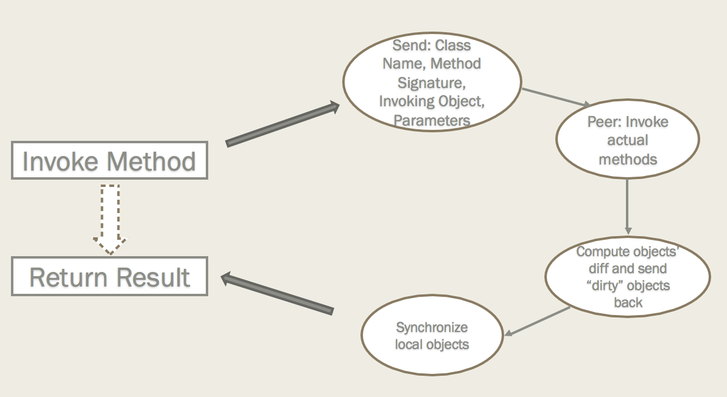
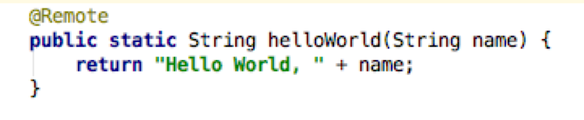
Example
What happens here:
Original Method:
Remote executable method:

Slide 5
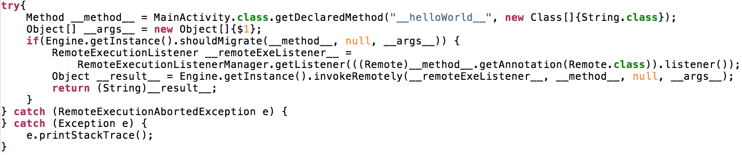
Example
Key Technique: bytecode manipulation
Following code is inserted into helloWorld(String name) method:

Slide 6
Demo

Slide 7
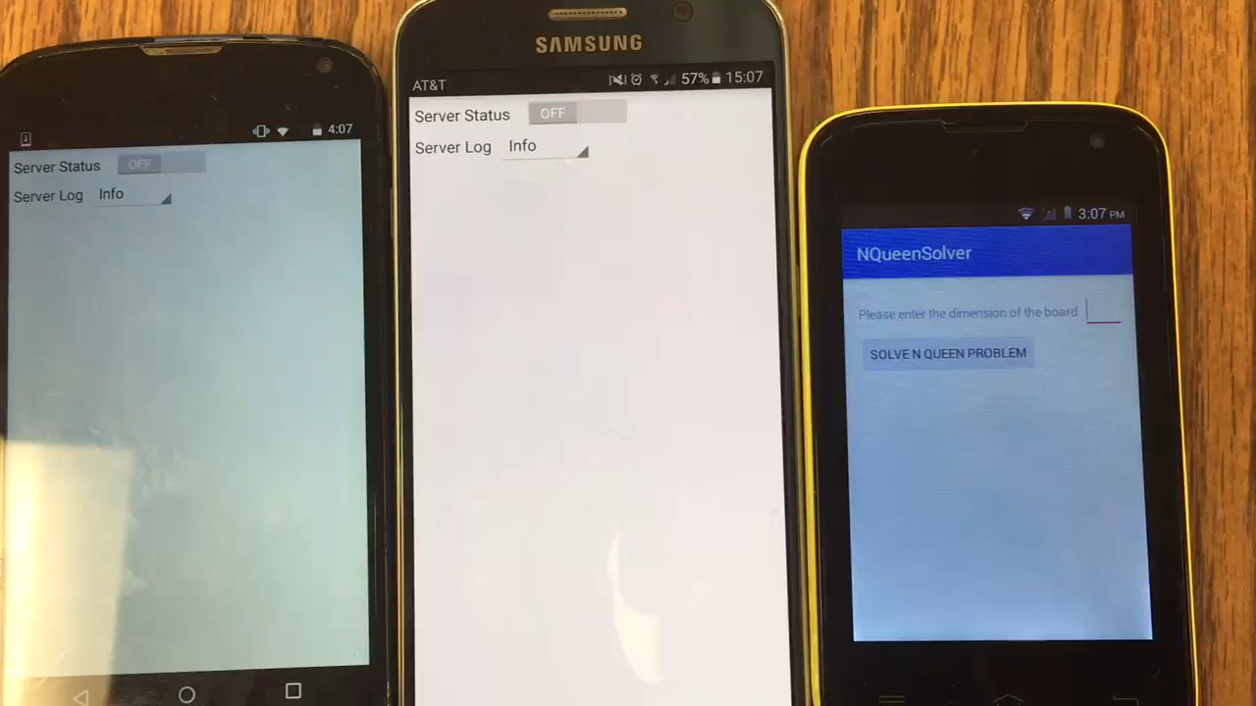

Slide 8
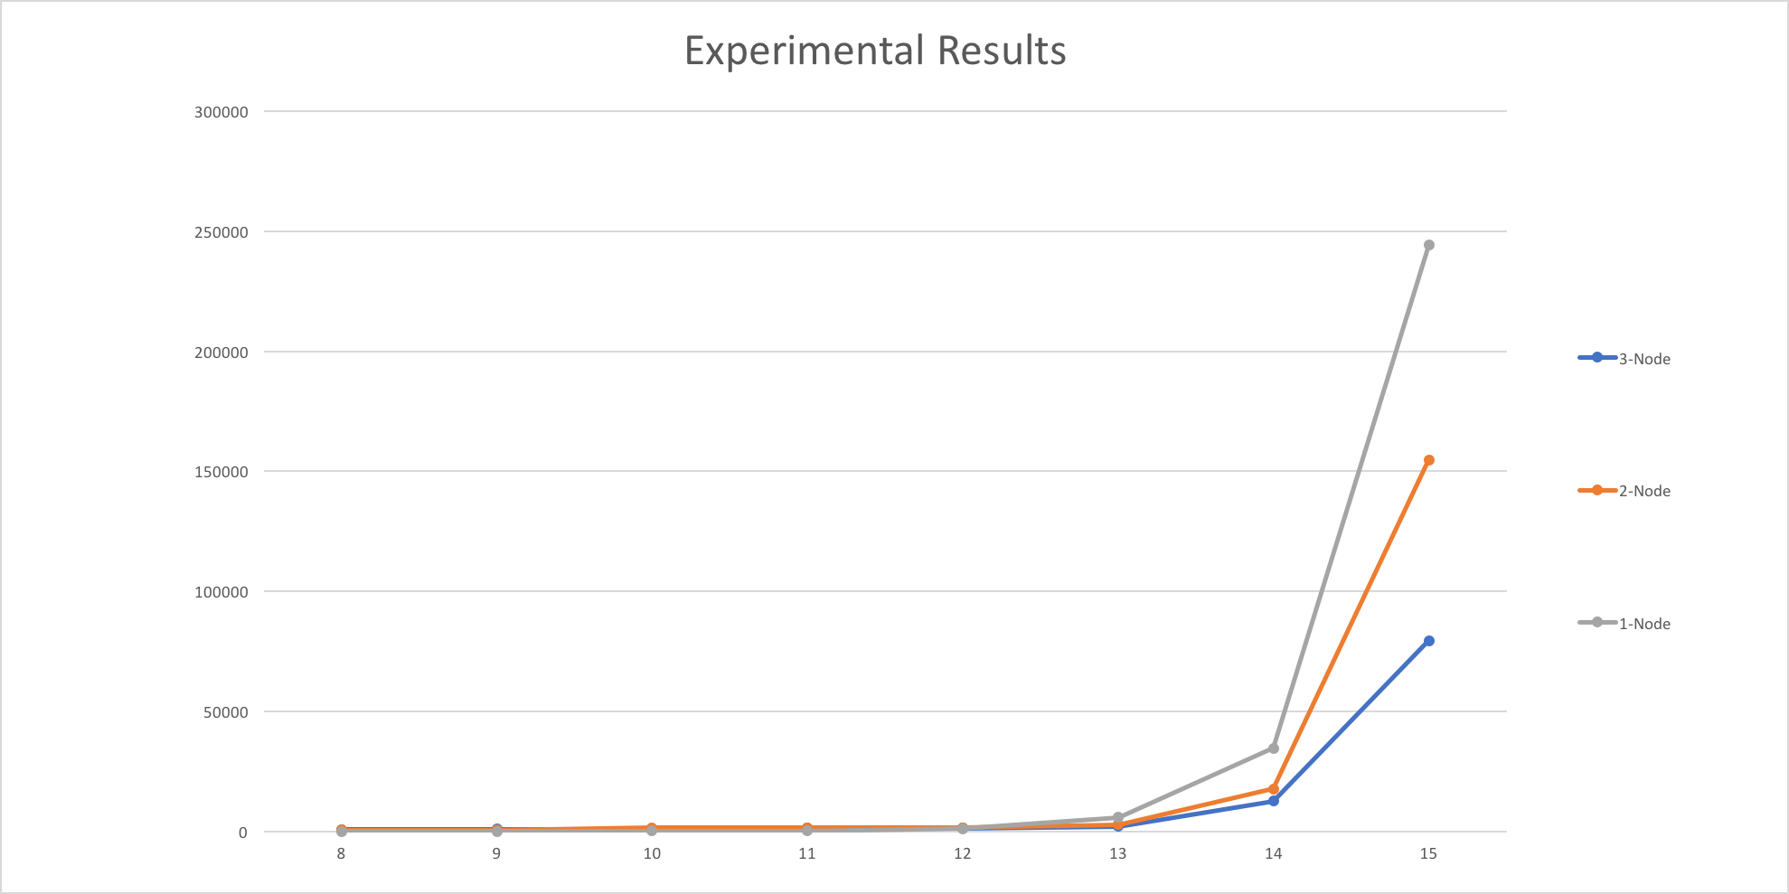
Experimental Result

